Slide 1

Mail-Art
Introduction to an art form often outside the mainstream Art-world
by Ruud Janssen – 22 sept 2008
Notes:
Lezing / Gastles op de Willem de Kooning Academie te Rotterdam op 22 September 2008

Slide 2
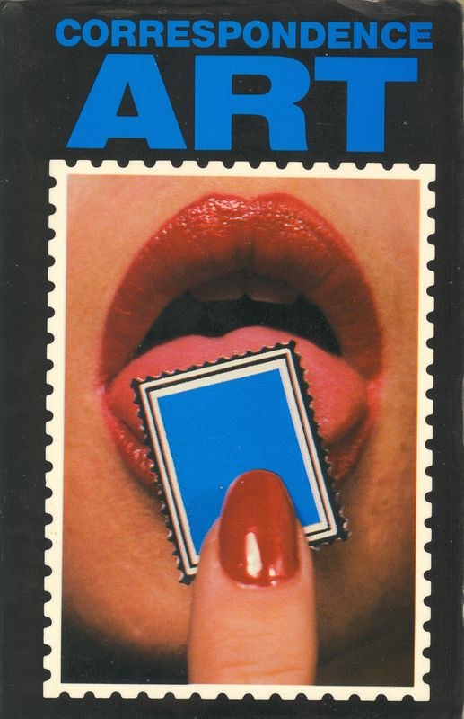
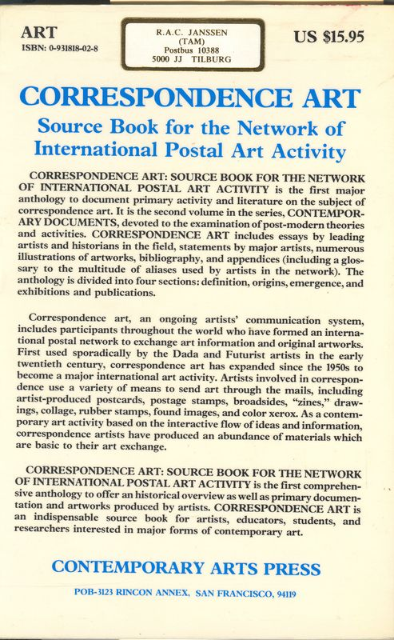
What is Mail-Art?
Notes:
Een van de eerste grotere boeken over Mail-Art / Correspondence Art. Michael Crane geeft een breed overzicht van het Internationale Mail-Art gebeuren. Gepubliceerd in 1984, en bevat dus veel historisch materiaal uit de beginfase.

Slide 3
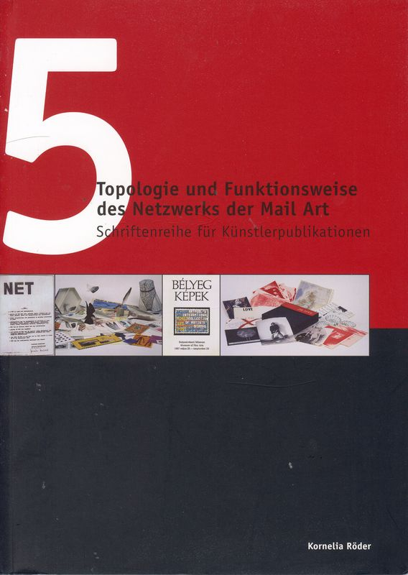
Thesis by Kornelia Röder – Schwerin Museum – Germany.
Notes:
Kornelia Röder: Topologie und Funktionsweise des Netzwerks der Mail Art. Seine spezifische Bedeutung für Osteuropa von 1960-1989

Slide 4
DaDa
History behind Mail-Art
Stijl
Kurt Schwitters
Marcel Duchamp
John Cage
Black Mountain College
Ray Johnson
CorresponDance
Robert Filliou
Eternal Network
Fluxus & Netwerk

Slide 5
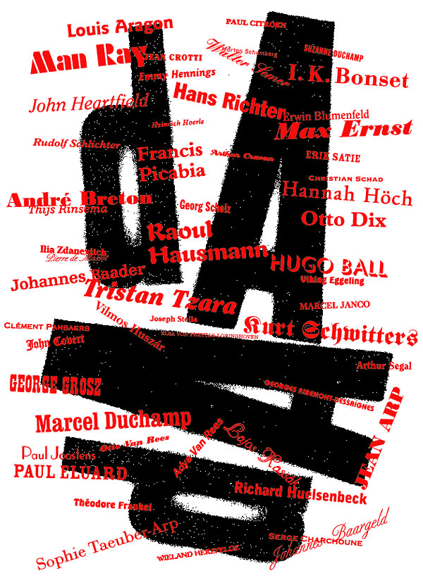

Slide 6
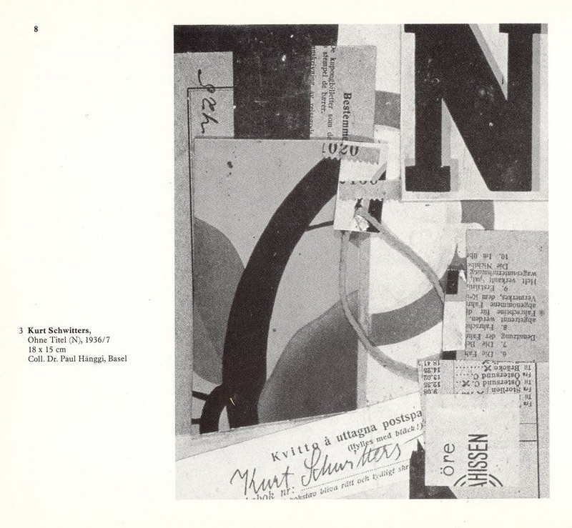
Collage as an artform. Already used by Kurt Schwitters who sent the results by mail as well

Slide 7
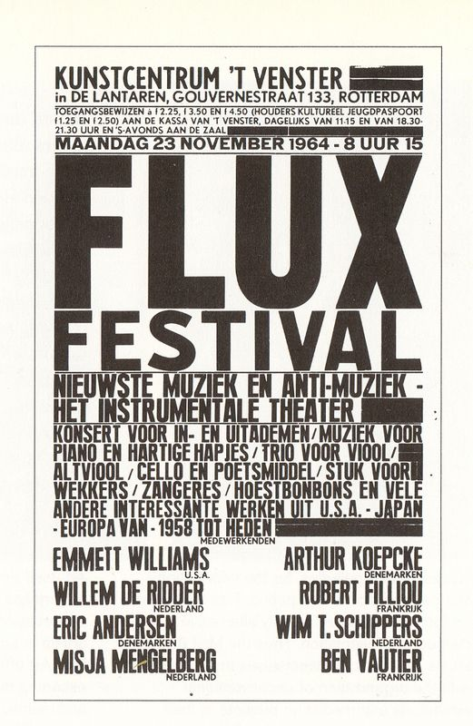
Notes:
Een Rotterdam’s Flux Festival met enkele bekende namen uit de Fluxus Wereld.

Slide 8
Fluxus—a name taken from a Latin word meaning "to flow"—is an international network of artists, composers and designers noted for blending different artistic media and disciplines in the 1960s. They have been active in Neo-Dada noise music and visual art as well as literature, urban planning, architecture, and design. Fluxus is often described as intermedia, a term coined by Fluxus artist Dick Higgins in a famous 1966 essay.
Source: Wikipedia (UK)

Slide 9
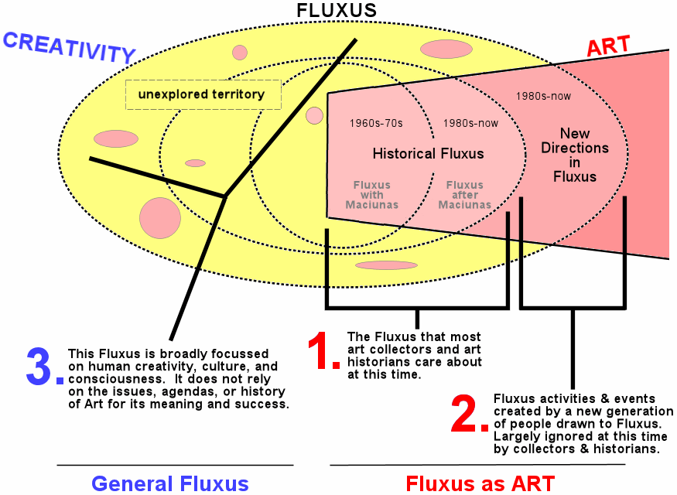

Slide 10
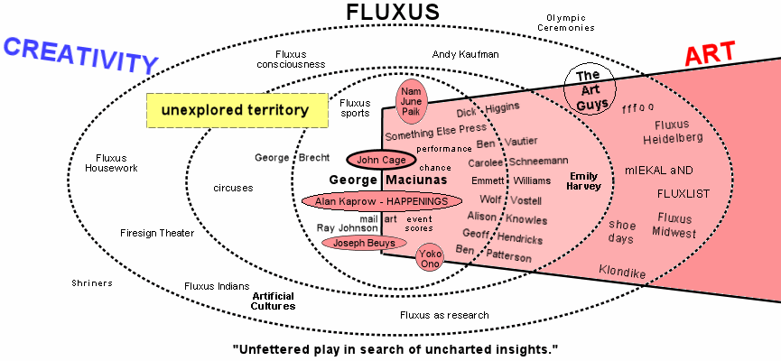

Slide 11
Most commonly, Mail-Art Network artists have made and exchanged postcards, designed custom-made stamps, or artistamps, and designed, decorated or illustrated envelopes.
Fundamentally, mail art in the context of a Mail Art Network is a form of conceptual art. It is a movement with no membership and no leaders.
Source: Wikipedia UK

Slide 12
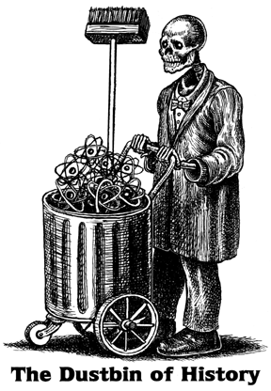

Stempel van “StickerDude” (Joel Cohen) en tekening door Thomas Kerr (beiden NY - USA)
Statement van Guy Bleus (België)
Notes:
Hoe sommige mail-artiesten denken over de ‘history’ die geschreven wordt is hier duidelijk te zien.

Slide 13
Mail art werd oorspronkelijk vaak gemaakt met behulp van stencils, stempels, xerografie en fotokopieerapparaten. Kenmerkend waren de veelal kleine formaten op een papieren ondergrond; wat te maken had met de eisen voor verzending per post.
The mailbox is a museum

Slide 14
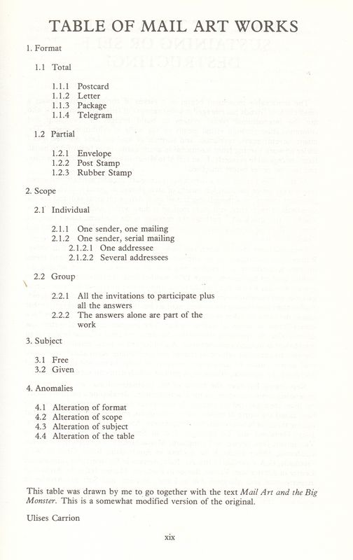
From book “Correspondence Art” by Dutch Ulises Carion from Amsterdam

Slide 15
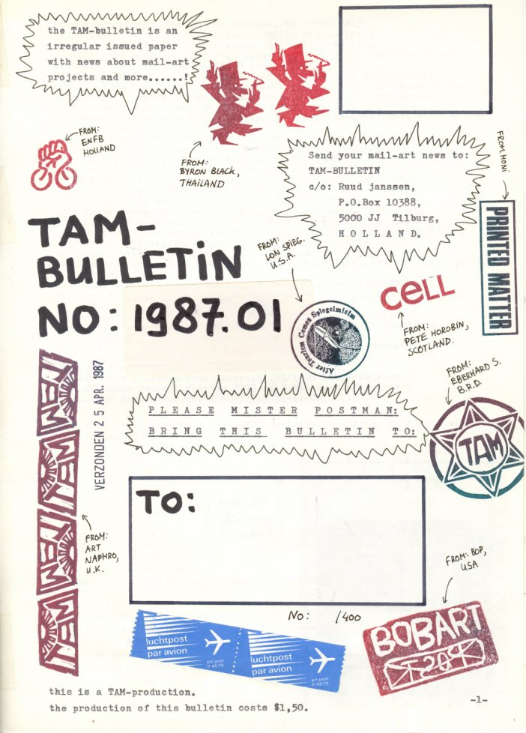
Sample TAM-Bulletin (1983-1989)

Slide 16
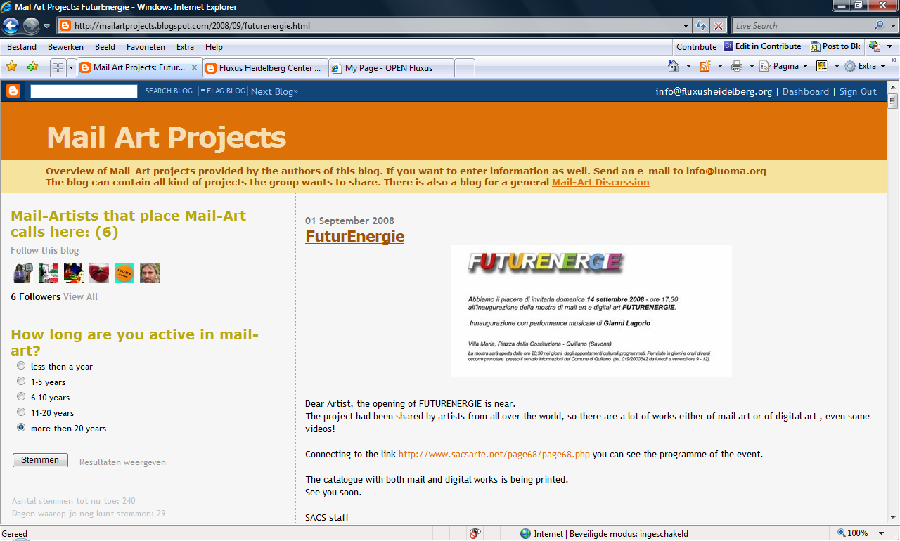
digital version of a BLOG where mail-artists place their calls.

Slide 17
Some samples of Concepts

Slide 18
IAC = International Artists Coorperation (Klaus Groh) 1972-1977
Image Bank Exchange – Canada 1970-1979
Mail Order Arte 1972 - USA

Slide 19
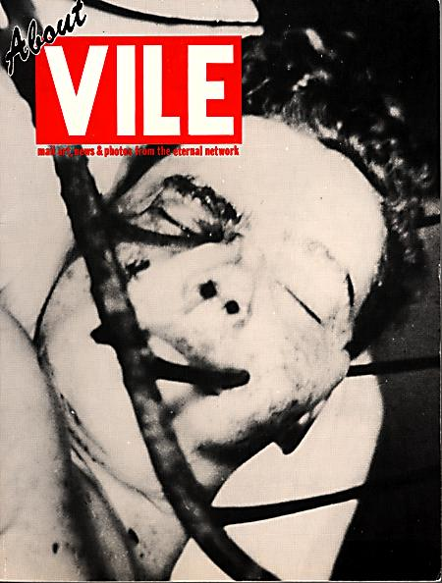

Vile –
Anna Banana & Bill Gaglione
Canada
(1974-1979)

Slide 20
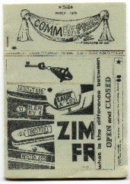
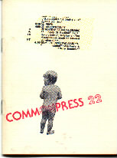
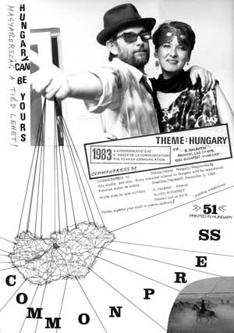
Commonpress – Pawel Petasz
(1977-1983)

Slide 21
Mail-Art kunstenaars wisselen via de post hun kunstwerken uit en omzeilen daarmee de traditionele kunstinstellingen bij het openbaar maken van hun werk.

Slide 22

The Source-book by John Held Jr - USA
Notes:
Toch proberen mail-artiesten na het omzeilen van de formele kunstwereld de zaken zo te documenteren dat het weer terug te vinden is in deze kunstwereld. Boeken over mail-Art zijn er velen geschreven. Ze zijn echter moeilijk toegankelijk voor buitenstaanders. Internet heeft wel vele teksten en illustraties toegankelijk gemaakt.

Slide 23
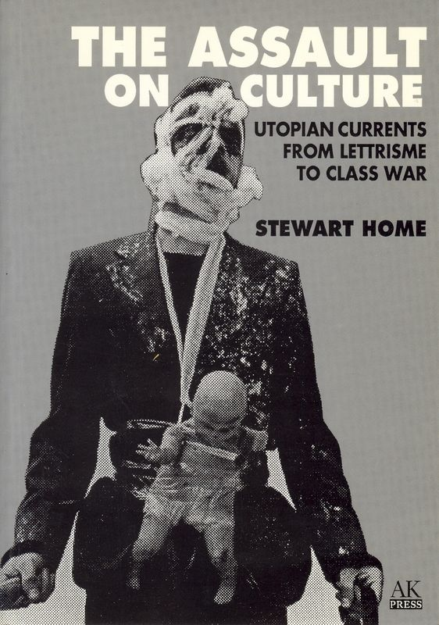
Stewart Home with his vision of the Artworld: Neoism, ArtStrike, Monty Cantsin, Karen Eliot.
Notes:
'Neoism', launched around 1978 by David Zack (U.S.A.) and Al Ackermann (U.S.A.), was a parody art movement and can be seen as a 'multiple name'. 'Neoism' was an open movement and each artist was free to call him/herself a 'neoist' and could contribute, re-interprete and add upon a given structure, to develop the movement according to their own needs. During its history three central strategies became an imported part of the 'Neoism' philosophy, namely the use of 'multiple names', 'art strike' and 'plagiarism'. The 'Neoism' movement represents the de-institutionalised art world and was itself a critique on being an "art movement". The movement had practitioners in Canada, the U.S.A. and in most countries in Western Europe.
'Neoism' found its origine in Portland (Oregon) when Zack and Ackermann started with the concept of 'multiple names'. In collaboration with and as homage to two friends with similar sounding names, namely Maris Kudzins (Canada) and Istvan Kantor (Canada) (who lived at that time in Hungary), Zack launched the 'Monty Cantsin' open-pop-star project in 1978. The use of multiple names was a reaction against false individualism in capitalist society, by artists using the same identity, or even descirtion was impossible. Everyone could adopt the name and in this way achieve pop stardom. A little bit later Zack, Ackerman and Kudzins founded the group that later became 'Neoism'.
Hungarian Istvan Kantor was one of the first to use 'Monty Cantsin'. Zack met Kantor in Hungary and encouraged him to move to the U.S.A. which he did in 1978. He stayed with Zack and Ackermann but his lack of English made it difficult for him to realise the term 'Neoism' was a joke. In 1979 Kantor moved to Montreal and, according to Ackerman, the word 'Neoism' was coined by Kantor soon after his arrival there. In Montreal Kantor gathered a group of younger artists around him and fashioned a collective identity for them as the 'Neoists'. Kantor became the fierce advocate of 'Neoism' and used the name the next five years. As he primarily worked as 'Monty Cantsin' for several years, Kantor said that he was the first and one and only 'Monty Cantsin' and his activities became associated with 'Monty Cantsin'. This caused that splinter groups started to develop their own groups, when they saw that Kantor made an open name his own.
One of these splinter groups was centered around Stewart Home (United Kingdom) from London. Before he came in contact with 'Neoism' and the open name concept, he launched in February 1984 the magazine Smile. A few months later in late April of 1984 he read about the 'Neoist' movement for the first time. By Smile's second issue in April 1984 he suggested to call all magazines Smile, to question authorship and anonymity and a creation in a collective approach to a shared or "open concept". Smile became soon the publication to propagate and develop its cultural critique through the three central strategies of 'Neoism', especially 'Plagiarism'. Material published in Smile was mostly 'plagiarism' from within the Mail-Art network and also from other issues and versions of Smile as well. Even material from sources outside 'Neoism' and Mail-Art was used.
Home called for the organisation of 'Festivals of Plagiarism', which was based on an end to the importance of originality as a component of the creative process. Neoists met each other in 'Neoist Apartment Festivals' or in 'Festivals of Plagiarism' in Austria, U.S.A., Italy, and many other countries up to the end of the nineties. 'Plagiarism' desires to remove ideas from a commodity driven economy and bring them back to an emphasis on its human value. While 'Plagiarism' has become for Mail-Art plagiarists a justification of photocopied collages. Home started also his own 'open name', 'Karen Eliot', as a reaction against Kantor calling himself the one and only 'Monty Cantsin'. The name 'Karen Eliot' has been created specifically for the 'Neoism' movement, and is described as a multiple signature for any form of (anti-)art, a kind of cultural terrorist. By 1986, after an argumentative 'Neoist Festival' in Ponte Nossa (Italy) organised by Emilio Morandi, Home had completely broken with 'Neoism'. He proposed a successor "movement" called 'Praxis', and focused on promoting the 'Art Strike' for 1990 to 1993. Originally put forward by himself in 1985 as class war against commody culture, the notion took on a life of it's own after 'Art Strike Action Committees' were established in such diverse locations as San Francisco, Baltimore, Ireland, and Uruguay. According to 'Praxis', all previous attempts at "revolutionary" art were inevitably subject to bourgeois recuperation. The solution, then, is a "refusal of creativity": "from 1990 to 1993 … artists will not produce work, sell work, permit work to go on exhibition, … This total withdrawal of labour is the most extreme collective challenge that artists can make to the state."
"We call for all artists in the U.S. to put down their tools and cease to make, distribute, sell, exhibit or discuss their work from January 1, 1990 to January 1, 1993. We call for all galleries, museums, agencies, alternative spaces, periodicals, theaters, art schools etc., to cease all operations for the same period. … Unlike Gustav Metzger's Art Strike of 1977 to 1980, the purpose is not to destroy those institutions which might be perceived as having a negative effect on artistic production. Instead, we intend to question the role of the artist itself and its relation to the dynamics of power within our specific culture." Home, S. (1988). Art Strike Handbook. London: Sabotage Editions
With his call for a literal art strike, he turned 'Neoism' from theory to practice. When he did not found followers for his 'Praxis' movement and saw that 'Neoism' was still alive, he returned to 'Neoism' and started to promote himself as "Neoism's primary theorist". He connected his 'Praxis' with 'Neoism' and the 'Art Strike' became part of 'Neoism'. The identity as an art "movement" that 'Neoists' tried to avoid was at the same time necessary when they wanted to make central strategies (art strike, plagiarism, etc.) significant, Home needed to turn the theory into practice from a non-movement to an actual movement that found itself in Mail-Art. This upset critics (often other 'Neoists') accusing Home of trying to historify 'Neoism' and turn it into an avant-garde movement, while 'Neoism's' goal was to create the illusion that there was a movement called 'Neoism'.
"… how many realize that the Home-initiated "Neoist Alliance"was designed to be an echo of a Situationist split? In other words, having failed to make himself 'important' with Praxis, having not been able to find a better 'movement' to associate himself with than Neoism, but wanting to redefine it in some way so that he could be its 'founder' or something of the sort, he created the Neoist Alliance. The NA having, by Home's own presentation of it, 'nothing' to do with Neoism. Confused? Good." tENTATIVELY, a cONVENIENCE. (2000). Neoist misalliance [www page]. URL http://website.lineone.net/~grandlaf/NEOMIS.htm
Most of the publications about 'Neoism' come from Home. But the historification by Home is inaccurate, in the book Neoist Manifestos for example he make writings which have been published earlier under multiple names his own. In contradiction with Zack and Ackerman whose only main feature of the 'Monty Cantsin' identity was to achieve fame, Stewart Home saw multiple names as a tool for political subversion instead. Home's political aspirations for his investigation were revealed by his choice of book title, The Assault on Culture.
Consequently, trying to get a correct history of 'Neoism' is almost impossible. Members were encouraged to create a different, opposite or fake histories and to spread confussion. Second, quarrels among Neoists and, later writers about 'Neoism', make it more difficult to get a true perspective of the movement especially in light of the ambitions of some Neoists who wanted to use 'Neoism' to make career in the artworld declaring themselves as the driving force of the movement. All of these various forces led to a split after the '9th International Neoist Apartment Festival' in 1985 in Ponte Nossa (Italy) organised by Emillio Morandi. Several members had a different look on 'Neoism'. For example one saw the use of multiple names as practical for not tracing the tracks while another see it from a point of view of art theory. Within 'Neoism' the struggle between theory and the practice has been a major problem.
"Well, no one is supposed to know what Neoism is and I don't think anybody does, including myself. The success of Neoism is basically in the question, "What is Neoism?" because everybody wants to know. There are millions of definitions and none of them are good for anything. But you could define it by saying Neoism is what makes Neoism more interesting than Neoism. Or you could say that Neoism is that which makes Neoism obsolete. " Total Zero. (n.d.). [www page]. URL http://members.eisa.com/~ec089540/monty.htm
'Neoism' was present in Mail-Art in the late eighties, but Mail-Art has never been a substantial part of 'Neoism'. Mail-artists took from 'Neoism' what was of interest for them without adapting their activities to the theory of 'Neoism' or add any substantial result to 'Neoism'. The most important contribution of Mail-Art in 'Neoism' was not the products which have been created, but the structure of interaction which has evolved. As such, Mail-Art proves to be a perfect expression of the collective personality, a collective and interactive approach to art. By 1985 the correspondence art network was packed with people using the Cantsin identity and countless editions of Smile had been produced by different individuals and groups world-wide. The theory of the 'Art Strike' was present in the Mail-Art network but was as quick as it came forgotten in the year 1990 and seems in contradiction with the year 1992 as the 'Decentralized Networker Congress' year.
'Neoism', had its roots in Fluxus and Situationism but was also influenced by Dada, punk and the industrial cultures. Fluxus was the inspiration for several aesthetic experiments within 'Neoism' such as performances, artists' books, video art and festivals. The Fluxus Festivals of the early sixties have inspired 'Neoism' for their 'apartment Festivals' which have been held in Germany, Italy, Canada, England and Canada, among other nations. If Fluxus was conceived as a critique of Modernist "movement" as actual stasis, 'Neoism' was meant in large measure as a critique of the very notion of the art "movement". 'Neoism' privileges non-object activities, it criticises the production of art as a market product and at the same time the creation of a process of theoretical and practical dialogue. For the Neoist, art is a privilege of the values of "individuality" and "creativity" which is denied by the economic reality of capitalism. Being an artist is a contradiction in a society in which culture, in all its forms (fine art, television, advertising) is a primary agent of political domination. So the relationship with their own "creativity" can only be doubtful.
"While Neoists place thier faith in practical philosophy, they DO NOT endorse the study of logic as pursued in the universities and other authoriarian institutes. Capitalism masters the material world by naming and describing those objects it wishes to manipulate. By rendering names meaningless, Neoists destroy the central control mechanism of bourgeois logic. Without these classifications, power cannot differentiate, divide and isolate the revolutionary masses. Because they are sick of the fragmentary world in which they live, the Neoists have agreed to adopt a common name. Every action carried out under the banner of a common name is a gesture of defiance against the Order of Power--and a demonstration that the Neonists are ungovernable. " Neoist Alliance (n.d.). [www page]. URL http://www.jaybabcock.com/neoist.html
False histories are endlessly generated to constantly breathe new life into the neoist myth and to resist art-historification. 'Neoism' has perfected this technique, surpassing its forebears Dada, Situationist, and Fluxus to the extent that even now, some thirty years after the movement started, art historians have done their best to ignore it, or to treat it as only a footnote to the more historical clear Mail-Art movement.

Slide 24
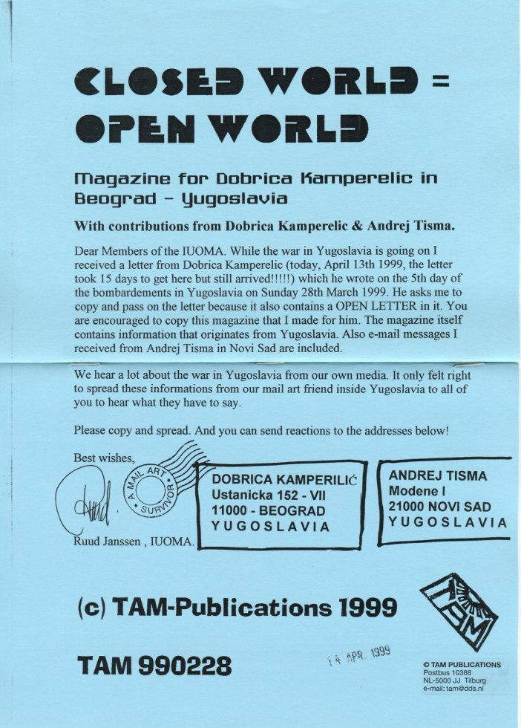
Open World by Dobrica Kampereliç (Yugoslavia). In War-times issued by TAM-Publications.
Notes:
Voorbeeld van Internationale samenwerking over de grenzen heen en in tijd van Oorlog.

Slide 25
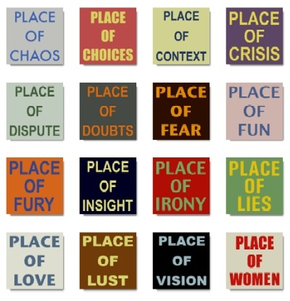
Conceptual digital work by mail-artist Hans-Ruedi Fricker (Switzerland)
Notes:
ONLY SENDERS CAN BE LOCATED.

Slide 26
De essentie van Mail-Art is de communicatie van de ene kunstenaar met de andere kunstenaar zonder tussenkomst van een ander.
A
B
Notes:
Guy Bleus heeft meerdere modellen van deze communicatie gemaakt

Slide 27
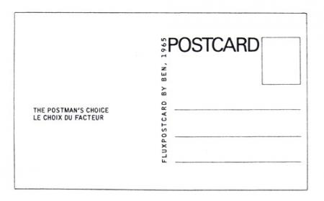
Both sides of the postcard by Ben Vautier were identical

Slide 28
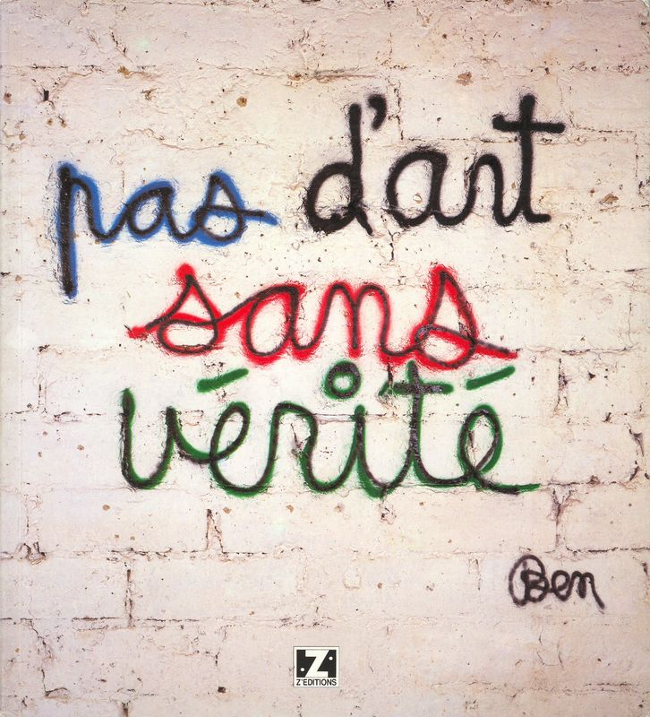

Slide 29
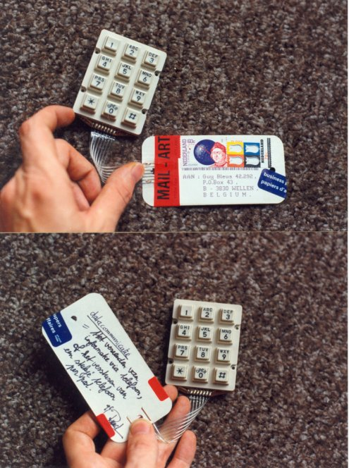
Experimenteel ingestelde kunstenaars probeerden echter alles te versturen waar zij een etiket en een postzegel op konden plakken; de verregaande standaardisering van de afmetingen van poststukken ontstond pas later.

Slide 30
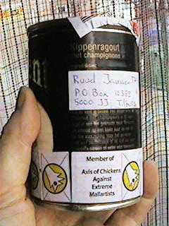
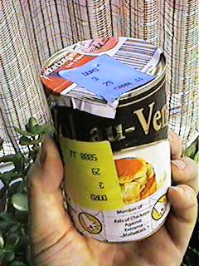
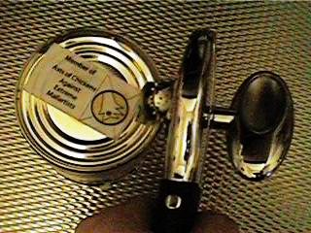
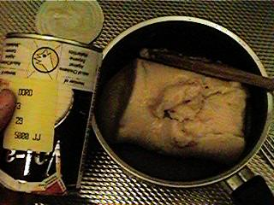
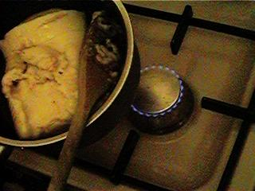
Sometimes you can eat Mail-Art?

Slide 31
@
Door de komst van Internet is een elektronische variant van mail art doorgebroken bij een groter publiek. Het versturen van e-mail werd een populaire manier van communiceren. BLOG’s en Forums werden actief. De groep mensen die zich hiermee bezig houdt breidt zich nog steeds uit.

Slide 32

Ray Johnson wordt gezien als de bedenker van deze kunststroming in de zestiger jaren. Hij wordt gezien als de 'vader' van de Mail art met zijn New York Correspondence School. De kunststroming vermijdt de officiële kunstwereld met zijn galerieën en musea en regelt in principe de verspreiding zelf.

Slide 33
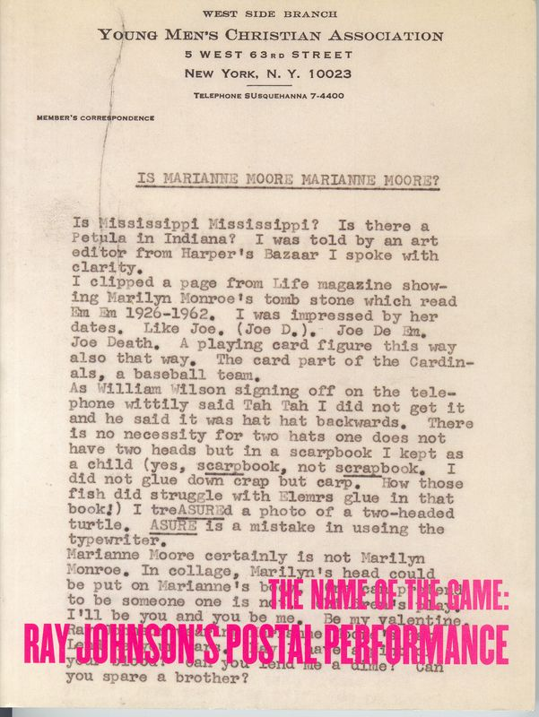
Catalogus van een van de reizende Ray Johnson Tentoonstellingen die ook in Nederland (Limburg) te zien was.

Slide 34
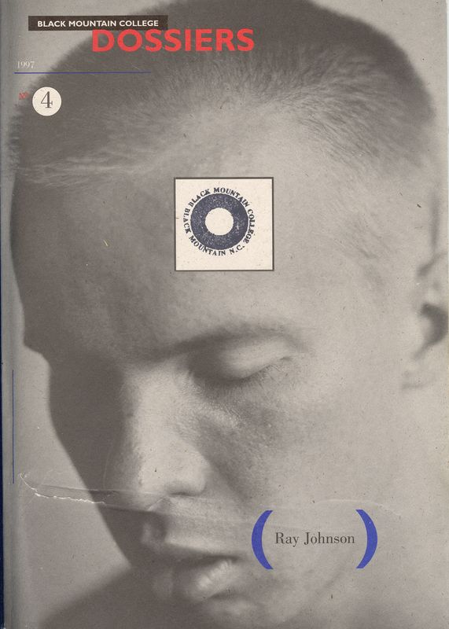
Boek uitgegeven door Black Mountain College. Tekst geschreven door Bill Wilson (NY) waarin hij praat over zijn leven en ontmoetingen.

Slide 35
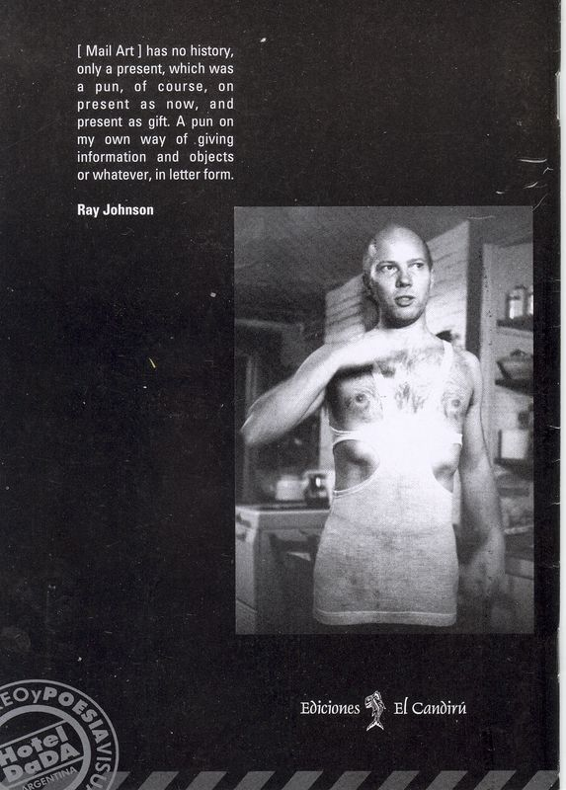

Slide 36

Ray Johnson was in contact met vele kunstenaars die wel in de officiële kunstwereld bezig waren.

Slide 37
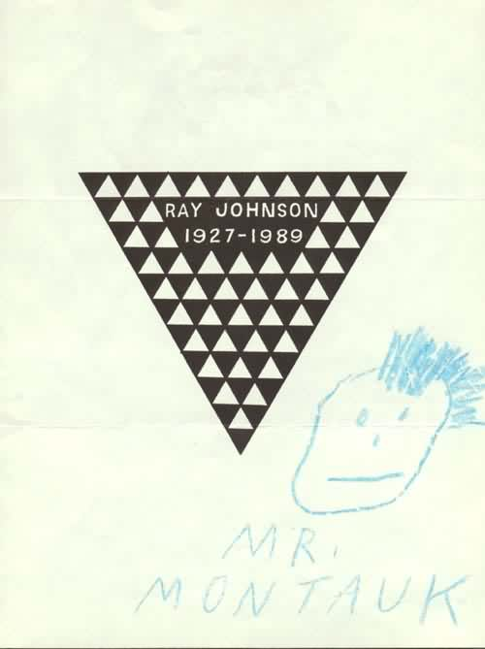
Death was always a concept Ray Johnson played with….

Slide 38
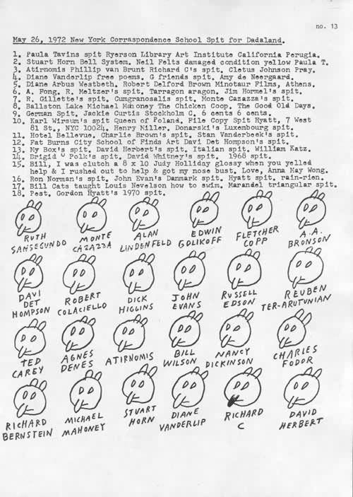
The Bunny’s by Ray Johnson

Slide 39
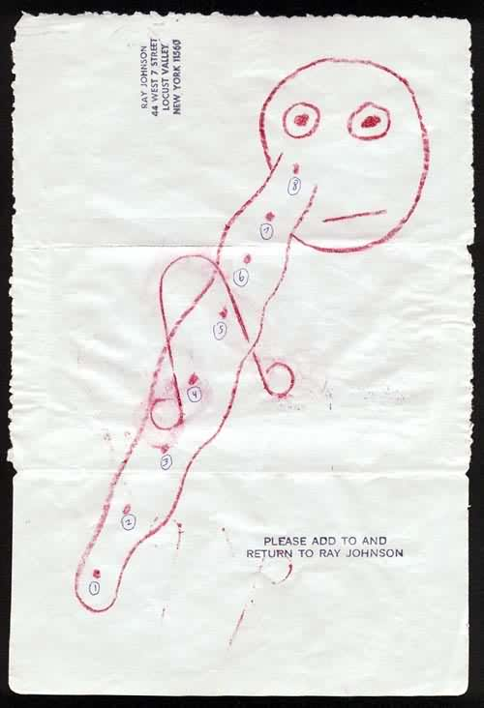
Please ADD TO and RETURN to Ray Johnson - Concept

Slide 40
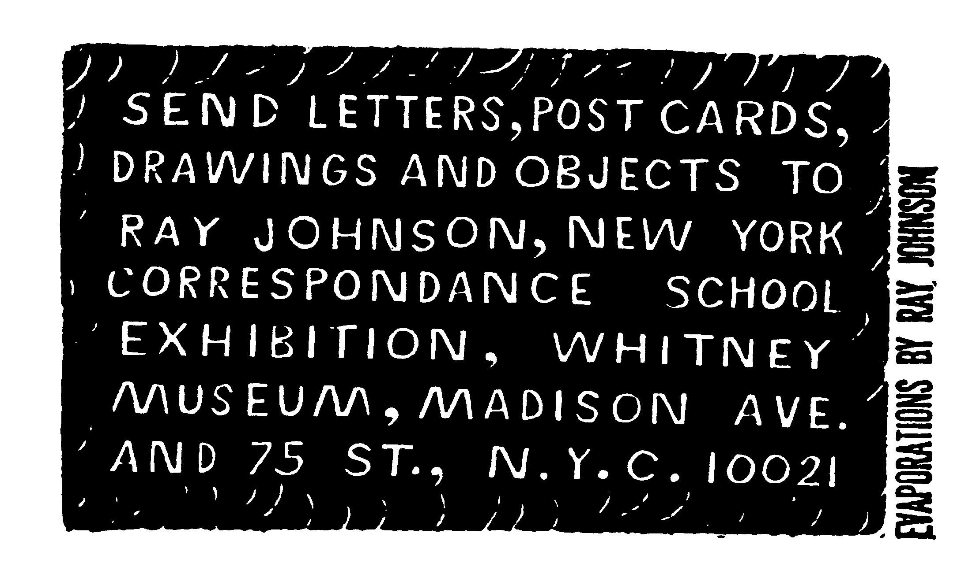

Slide 41
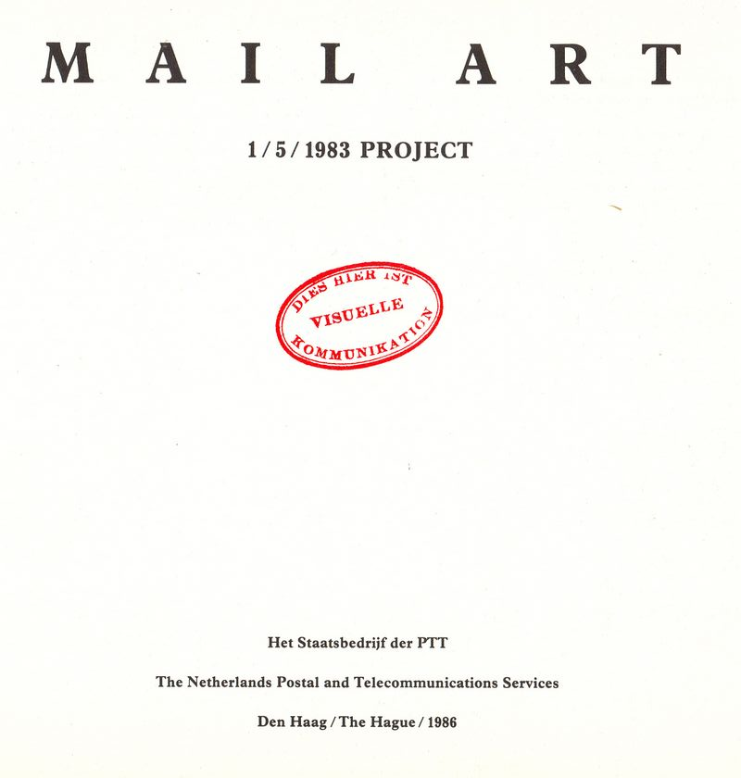
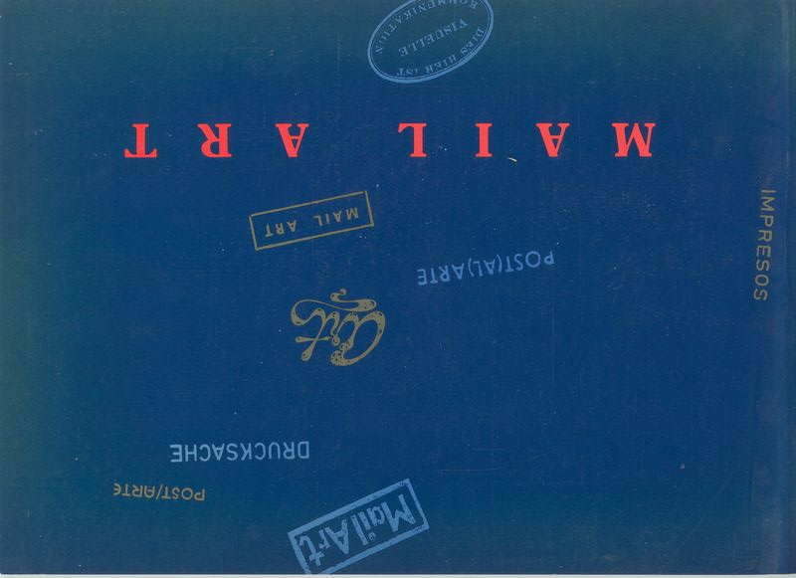

Slide 42
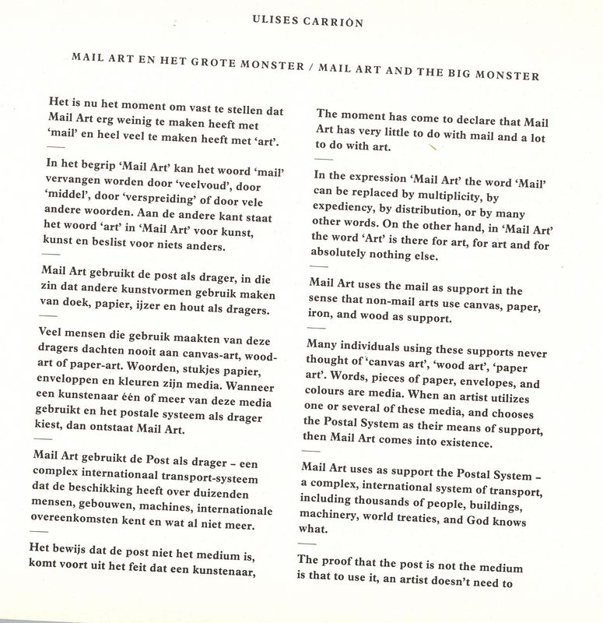

Slide 43
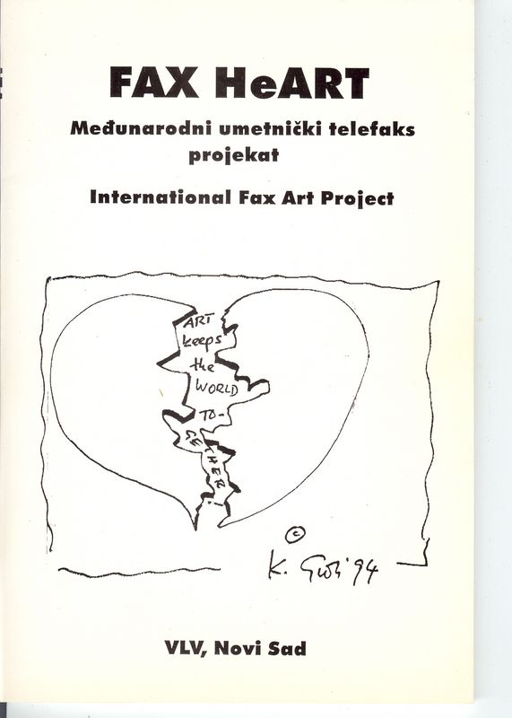
The FAX as communication-medium for a mail-art project

Slide 44
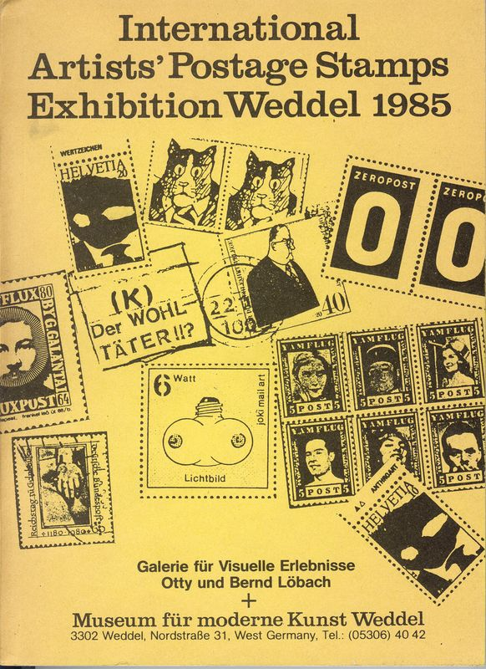
The ‘Artistamp’ as medium in for a mail-art project

Slide 45
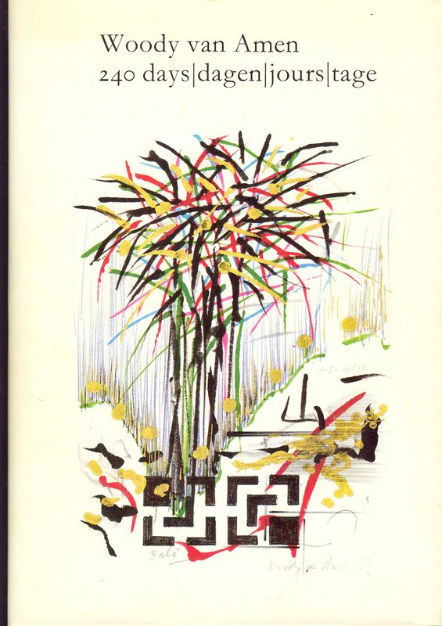
Er zijn over de jaren vele Nederlanders actief geweest in Nederland. Soms ook in Rotterdam….

Slide 46
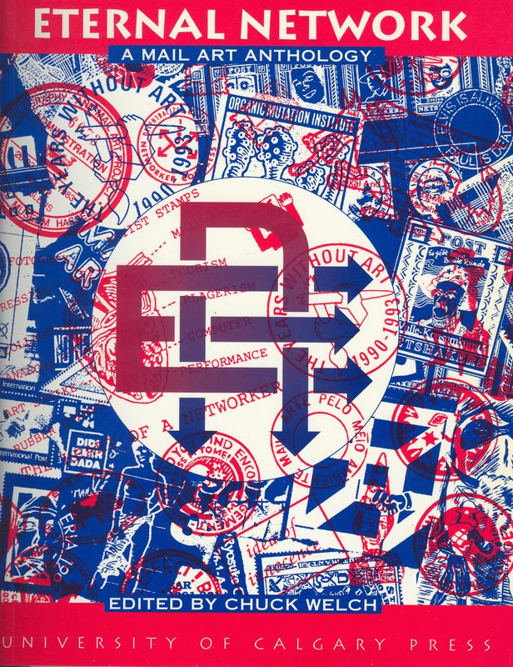
Book by Chuck Welch (CrackerJack Kid) - USA
Notes:
Dit is een nieuwere Anthologie over Mail-Art en bevat meer recente informatie over de veranderingen.

Slide 47
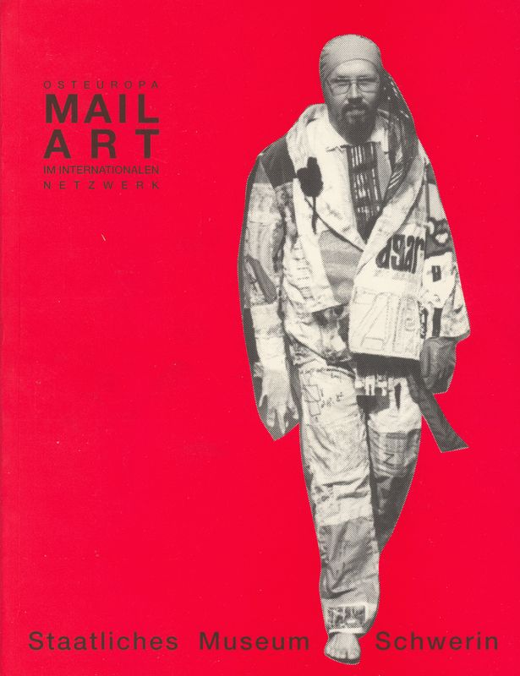
Een onderzoek naar de rol van Mail-Art voor Oost-Europa na de val van de muur in Berlijn.

Slide 48
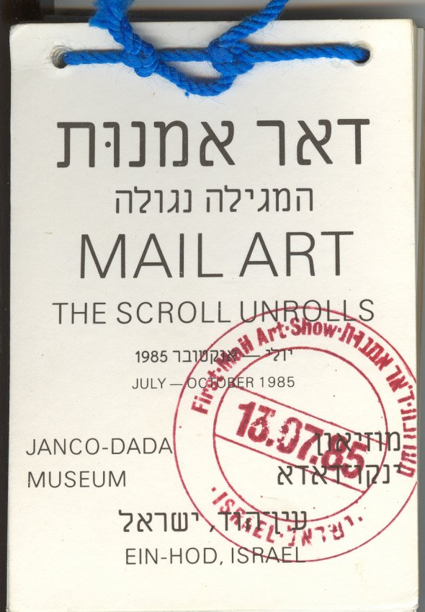
Een eerste project in Israel, uitgevoerd door David Cole (USA)

Slide 49
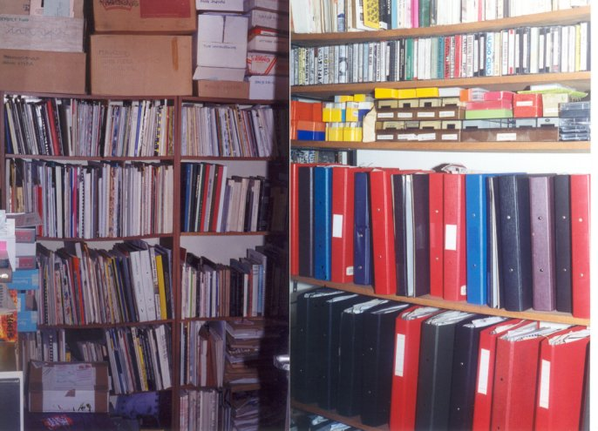
Mail-Art Archive of Robin Crozier (UK)

Slide 50
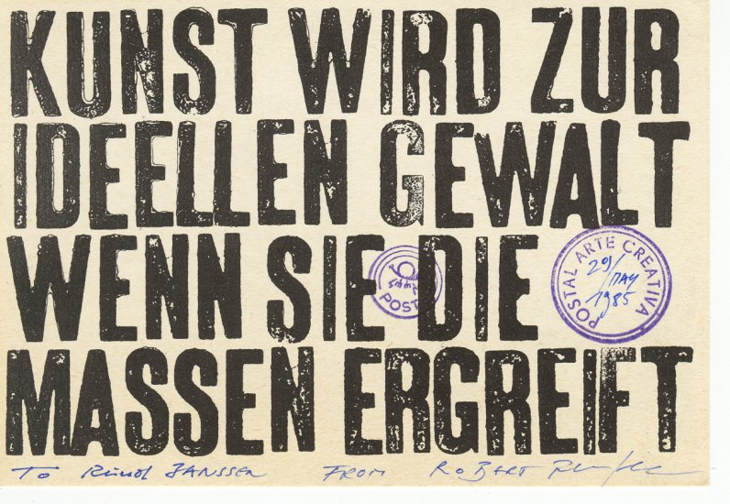
Card by Robert Rehfeldt
(East-Germany)

Slide 51
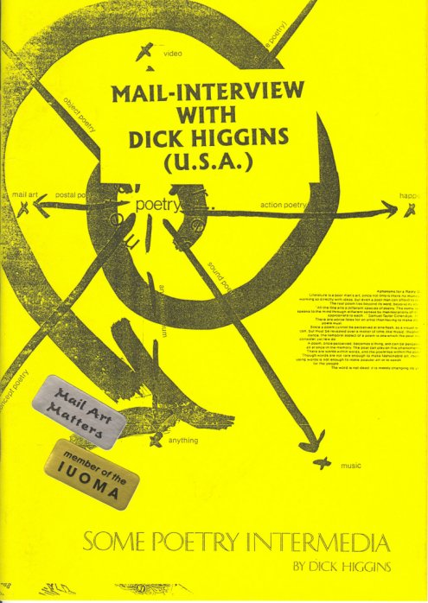
Fluxus en Mail-Art (interview).

Slide 52
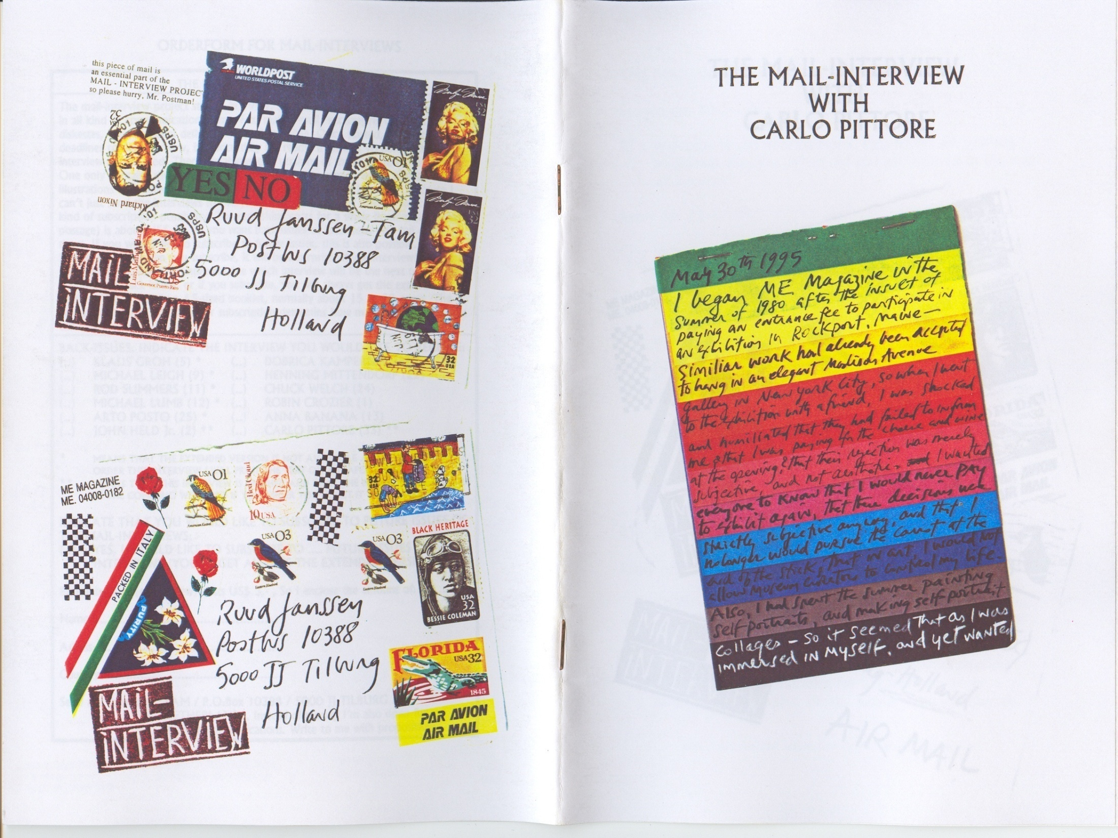

Slide 53
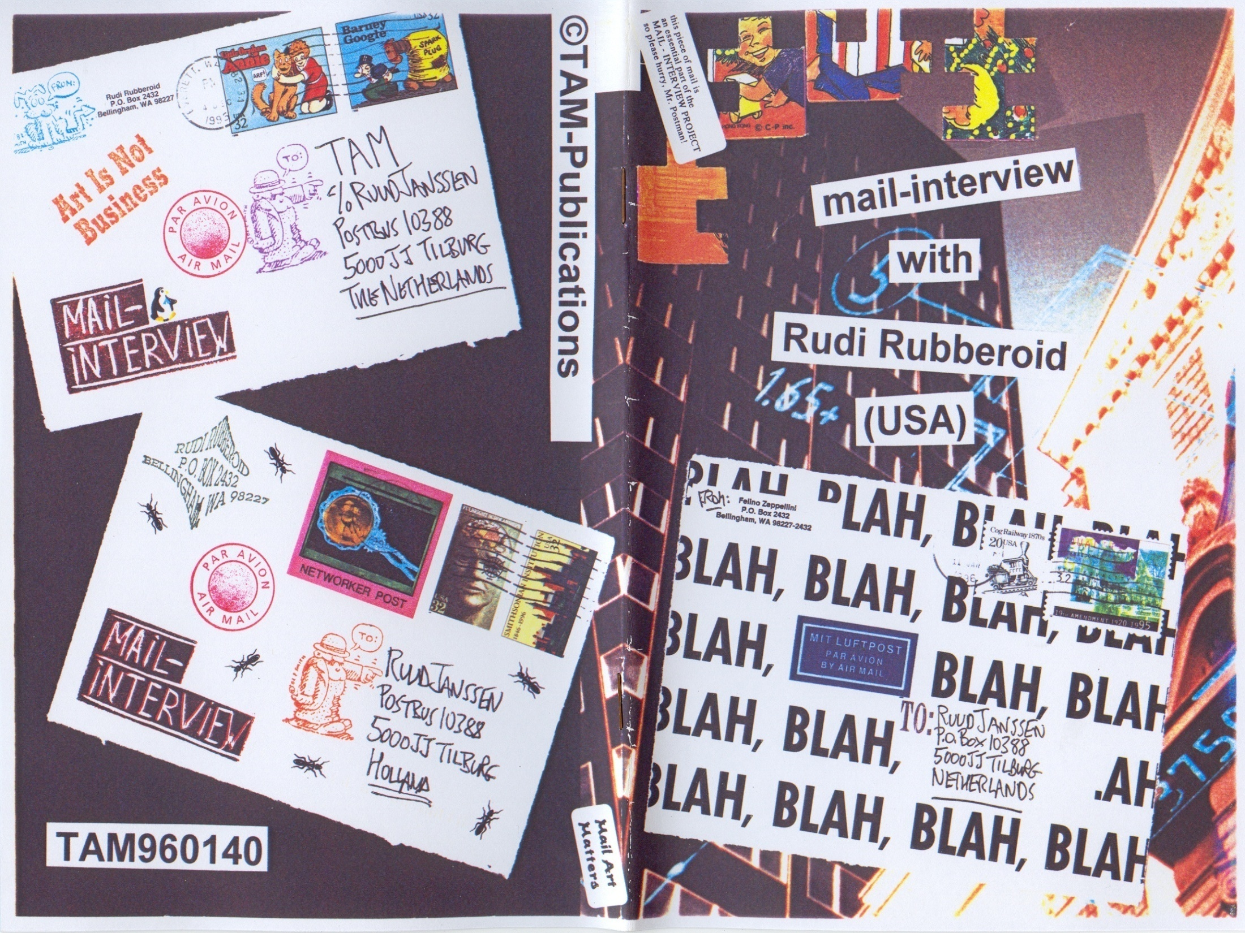

Slide 54
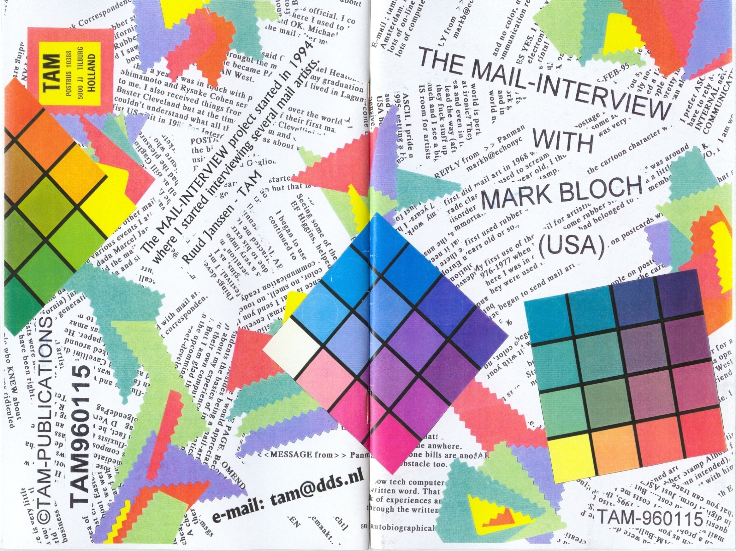

Slide 55
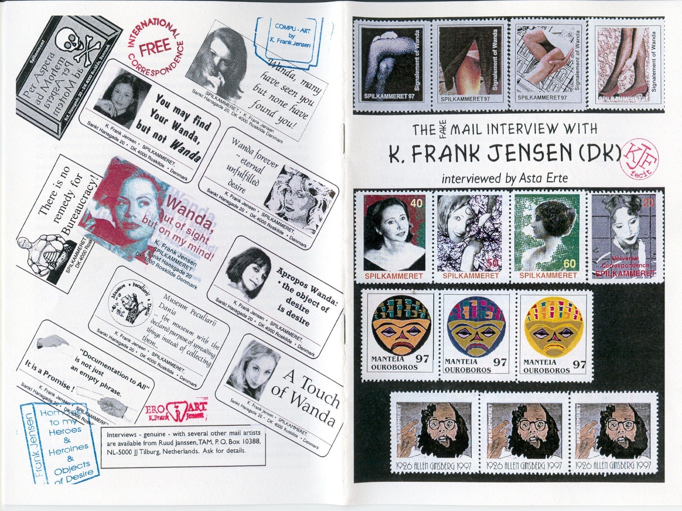

Slide 56


Slide 57

Mail-Interview Project – Endresult of a 6-year project.

Slide 58


Slide 59

The wellknown Memo(Random) project by Robin Crozier (UK)

Slide 60

Artistamps by Maciunas (received from Jon Hendrickx , Author ‘Fluxus Codex’)

Slide 61

A lot of ‘Zines’ in the Mail-Art netwerk are published

Slide 62

Project by Ryosuke Cohen from Japan

Slide 63




A longterm project started in 1983

Slide 64


Slide 65


Sample of an ‘eraser carved’ stamp by Litsa Spathi
Bron: www.iuoma.org/eraser.html

Slide 66

Notes:
Enveloppe naar RSM. Later ook gepubliceerd bij een 4 bladzijdes lang artikel / interview met mij.

Slide 67

‘erased carved stamp’, by Malinda Welt (2005)

Slide 68

Notes:
Envelope naar Stangroom. Zeefdruktechnieken, stickers, stempels.

Slide 69


Slide 70

First large exhibition Archive(1996)

Slide 71

Second large exhibition (2004)

Slide 72


Slide 73


Slide 74


Slide 75


Slide 76

Concept IUOMA started in 1988 (jubileum ‘artistamp’ in 2005)

Slide 77

Humor in Mail-Art

Slide 78

Agressive Mail-Art

Slide 79

Notes:
Onderdeel van een grotere serie – Acryl beschilderde enveloppen

Slide 80


Slide 81

Notes:
Vreemde vormen versturen per post. TAM-logo naar Guy Bleus.

Slide 82


Slide 83

Notes:
www.iuoma.org

Slide 84

Sinds de komst van BLOG’s is veel van wat er in Mail-Art gedaan wordt ook digitaal te volgen.

Slide 85


Slide 86


Slide 87


Slide 88


Slide 89
Q’s ?

Slide 90
Ruud Janssen (1959) is een Nederlands kunstenaar. In het dagelijks leven is hij docent. Hij woont en werkt in Breda.
Levensloop
Janssen heeft sinds 1980 diverse tentoonstellingen, publicaties en interviews georganiseerd in het Mail Art netwerk. In 1985 was hij een van de eerste kunstenaars die experimenteerde met datacommunicatie middels een eigen BBS (Bulletin Board System) om zijn mail-art tijdschrift elektronisch toegankelijk te maken. In de jaren 1994 tot 2001 interviewde hij meer dan 80 Mail-Art en Fluxus-kunstenaars. De resultaten publiceerde hij in boekjes en later ook op het Internet.
Contact
P.O.Box 1055 / 4801 BB Breda / Netherlands
E-mail: info@iuoma.org

